Slide 1
How is life?
OECD perspectives on people’s well-being
Meeting of the WWW Advisory Board
30 April 2015, Washington D.C.

Slide 2

Growing recognition and number of initiatives
  Stiglitz-Sen-Fitoussi report
  EU 2020; Eurostat sponsorship
  G20 Leaders statement to “encourage work on measurement methods so as to better take into account the social and environmental dimensions of economic development”
  UN Resolution calling for “holistic approach to development” to promote sustainable happiness and well-being
  Rio+20 Sustainable Development Goals
  Many national initiatives for measuring well-being
In 2011, the OECD launched its Better Life Initiative as part of its new mission to achieve Better Policies for Better Lives
Notes:
Better Life Initiative: Introduction
On the basis of this work, in 2011, the OECD launched its Better Life Initiative as part of its new mission to achieve Better Policies for Better Lives
The Better Life Initiative is very much in line with other similar “beyond GDP” initiatives:
Stiglitz-Sen-Fitoussi report
EU 2020; Eurostat sponsorship
G20 Leaders statement in Nov. 2009 in Pittsburgh and in June 2010 in Toronto asking to “encourage work on measurement methods so as to better take into account the social and environmental dimensions of economic development”
UN Resolution calling for “holistic approach to development” to promote sustainable happiness and well-being
Rio+20 Sustainable Development Goals
National initiatives for measuring well-being
UK’s Measuring National Well-being Programme
Measuring Australia’s Progress
Italian Benessere equo e sostenibile (Bes)
2

Slide 3
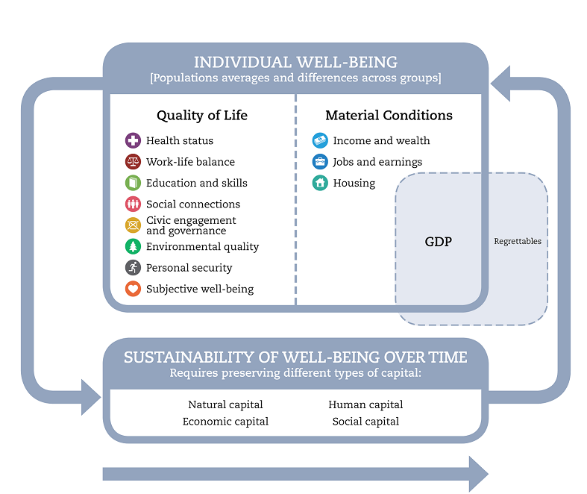
How can we think about well-being?
The How’s Life? framework
People rather than economic system or GDP
Outcomes rather than inputs and outputs
Both averages and inequalities
Both objective and subjective aspects
Both today and tomorrow
Notes:
OECD framework:
2 main domains : material conditions; quality of life
Plus sustainability
In line with Stiglitz-Sen-Fitoussi report and with many national initiatives (UK, France, Italy, Germany, etc…). Mexico has adopted the OECD framework

Slide 4











Populating the framework
Monitoring countries’ performance across 11 dimensions through dashboard of OECD Indicators:
25 headline indicators, around two per dimension
About 30 secondary indicators to complement the analysis on specific topics
Selection process involving OECD Committee on Statistics and Statistical Policy
Covering OECD and key partner countries

Slide 5

Principles for selecting indicators
Relevance
  face valid (does it match what you want to capture?
  clear interpretation (is ‘more’ better?)
  policy relevant (can it be changed?)
Data considerations
  official or established sources (non-official place-holders)
  comparable/standardized definitions
  maximum country-coverage
  recurrent data collection
  can be disaggregated by population groups

Slide 6
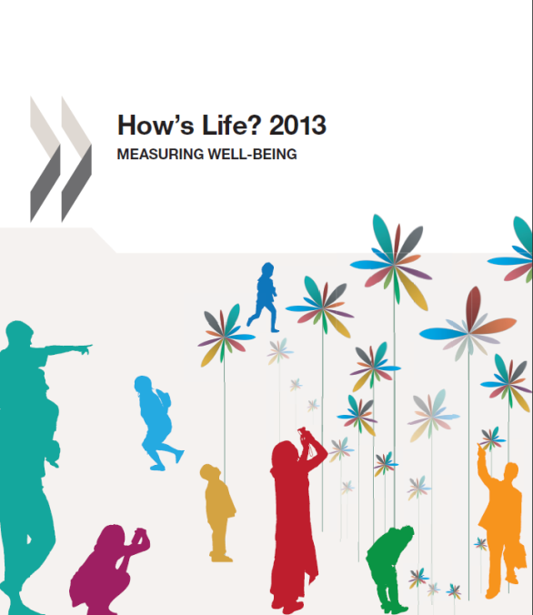
Dissemination: How’s Life?
Measuring what matters in people’s life
The human costs of the financial crisis
Well-being in the
workplace
Gender gaps in well-being

Slide 7
How to report on countries performance?
Notes:
Latin American countries included are: Brazil, Chile and Mexico
Both averages are weighted
As you can see Latin America performs better than the OECD in subjective well-being only.

Slide 8
How to report performance? (2)
Notes:
Note that this graph is based on data from How’s Life 2013 whereas the spider charts on the following slides are based on 2014 BLI data.

Slide 9
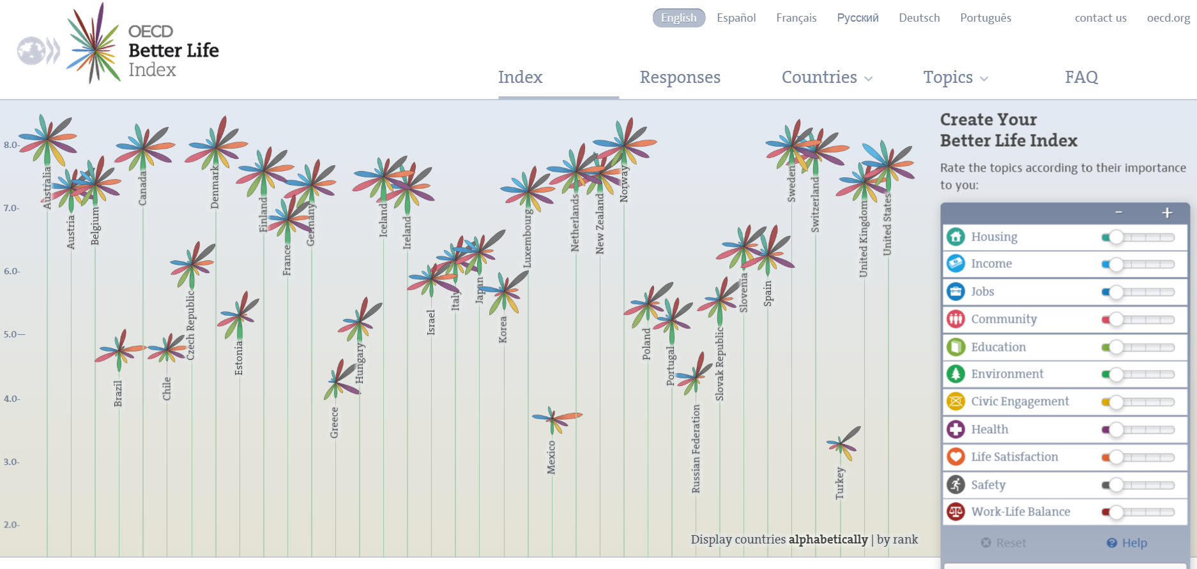

Engaging users: the OECD Better Life Index (‘default’ weights)
Notes:
What is the Your Better Life Index? It is a web-based tool, based on the headline indicators included in How’s Life? (properly normalised to a range between 0 and 1, so that they can be compared across domains), whereby users can give their own weight on what matters to them (by clicking on the right-hand menu of the screen). As a result of this choices, users generate their own index, where the height of the flower indicates countries’ average performance, and the width of each of the eleven petals indicate the importance that the user has given to them, and its height is the performance in the dimension considered.

Slide 10
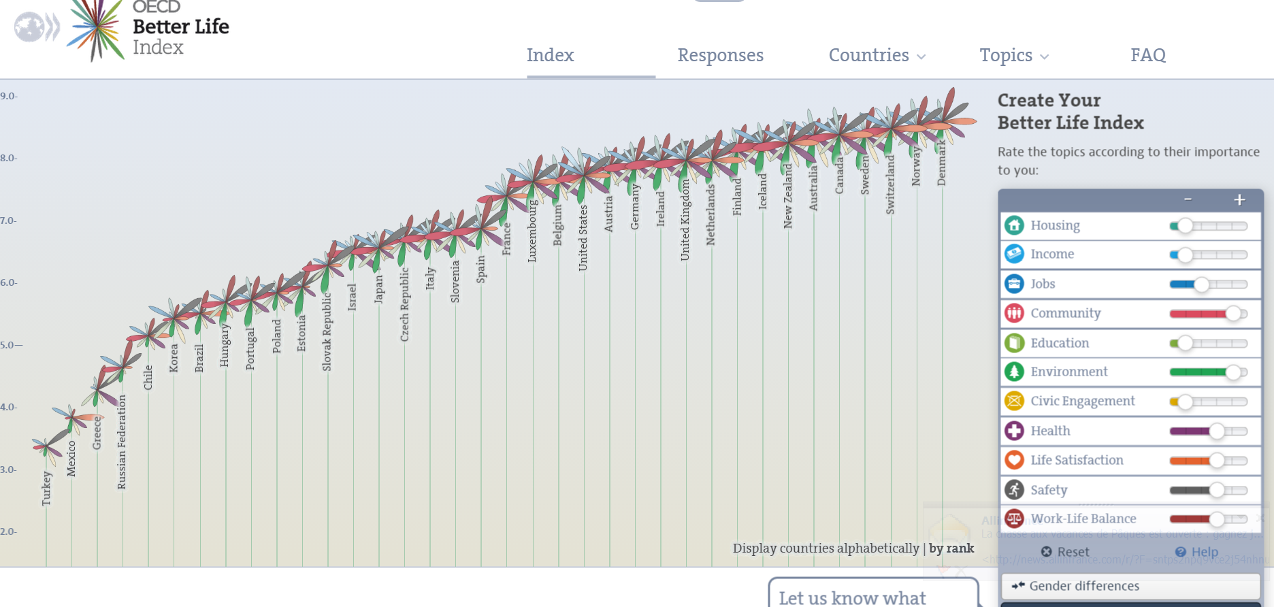
.. and based on weights set by users
http://www.youtube.com/watch?v=0Ct4lptAkVA
Notes:
You can generate your index, rank countries, and change the weight, and you will see online how your choices affect average country performance.

Slide 11
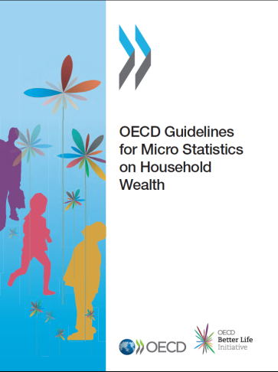
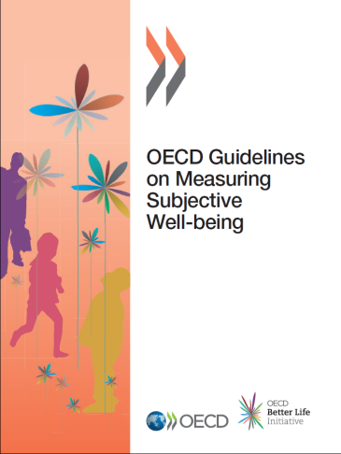
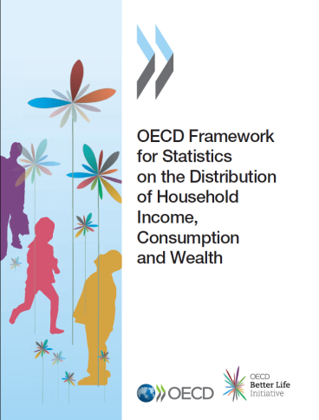
Improving metrics of well-being
Guidelines on Measuring
Subjective Well-Being
Framework for Measuring
Income, Consumption and Wealth;
Inequalities in the National Accounts
Guidelines for measuring Household Wealth; wealth distribution dataset
Measures of Social Capital
Green Growth Indicators
Job Quality indicators
Notes:
Better Life Initiative: Work on improving the measurement of well-being
We have also been pursuing methodological work in a variety of fields to improve existing measures of people’s well-being:
Guidelines on Measuring Subjective Well-Being
Framework for Measuring Income, Consumption and Wealth; Inequalities in the National Accounts
Guidelines for measuring Household Wealth; wealth distribution dataset
Measures of Social Capital
Green Growth Indicators
We are also developing country-specific analysis to provide the country with a framework for conducting a “well-being diagnosis”, the first issue of this series will be How’s Life in Israel, to be launched in the Fall.
This work is starting to influence the way the OECD assesses countries. For instance the Economic Review of Austria and of USA, as well as the Multidimensional Country Reviews of some non-OECD countries (Myanmar, Uruguay and Philippines) have included well-being analysis.
We are also starting to get recognition at the political level:
Chairman Ben S. Bernanke, U.S. Federal Reserve
Parliamentary Assembly of the Council of Europe
Earl of Dundee, a member of the UK House of Lords
….are only a few example of those who have cited the OECD work on measuring well-being.

Slide 12
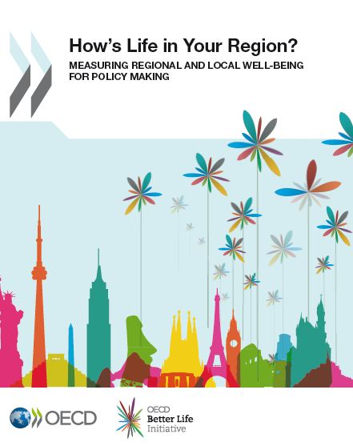
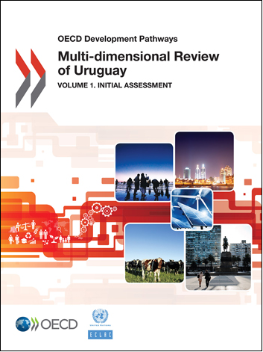
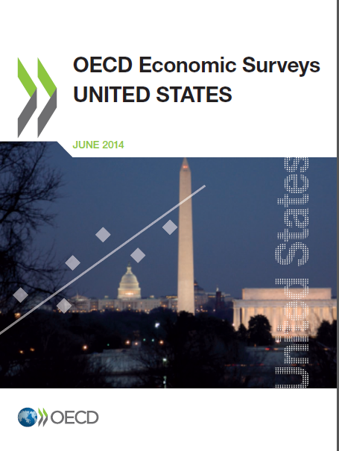

Well-being work throughout the OECD
How’s Life in your Region?: drilling down to the regional level
Multi-dimensional Country Reviews: Monitoring well-being outcomes in a development context (e.g. Myanmar, Uruguay, Philippines…)
Well-being in OECD Economic Surveys (e.g. Austria 2013, United States 2014, Mexico 2015, Italy forthcoming): moving beyond traditional economic assessment to also address well-being needs
Historical perspectives: How Was Life?

Slide 13

Well-being and Policies
What the Inclusive Growth policy framework aims to achieve:
Avoid : ‘Grow first, think about well-being later’
  Provide a clear link between some of
  the dimensions of well-being and policies
  Identify the main channels of transmission
  Make explicit the policy trade-offs and and and synergies
Be flexible and adaptable to country-specific challenges and circumstances
NAEC

Slide 14
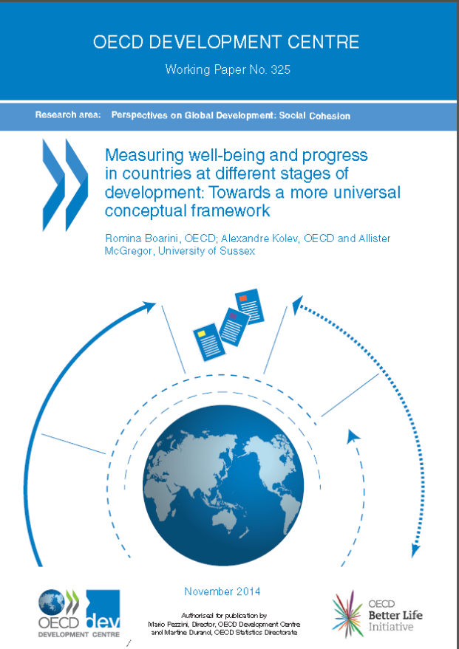
Well-being and development
OECD Development Centre working paper on “how to measure well-being in countries at different stages of development” (Boarini, Kolev and McGregor)
Are the same well-being dimensions relevant in all countries? i) none of the dimensions in the OECD framework can be deemed as ‘irrelevant’ for less developed countries; ii) but adaptations needed
Ongoing discussions on the successor to the MDGs in 2015: broader and universal focus
Notes:
When considering the findings from the range of well-being measurement initiatives being pursued around the world (e;g Mexico, Philippine or Morocco) alongside the increasing number of studies on well-being and quality of life in developing countries, it is apparent that there is nothing about the OECD framework that would limit its application to developing country contexts. OECD research led by the Development Centre and STD show that all of the dimensions that are included in the OECD framework are relevant for the hopes, aspirations and efforts of people in developing countries. The specific adaptations proposed in the adjusted framework mainly aim to add specific considerations that have particular significance for different economic and cultural contexts, and to reformulate some dimensions in ways that better resonate with policy-makers and practitioners in countries at all levels of development.

Slide 15
Thank you!
marco.mira@oecd.org

